Slide 1


Version Control Systems
Hagar Elgabry 05/17/2022

Slide 2
AGENDA
1
What is Version Control systems (VCS) and What Are Its Benefits?
2
What are Git and GitHub?
3
What are common words used in VCS?
4
What are version Control best practices?
5
Live Demo
6
List of useful Git & GitHub Commands

Slide 3
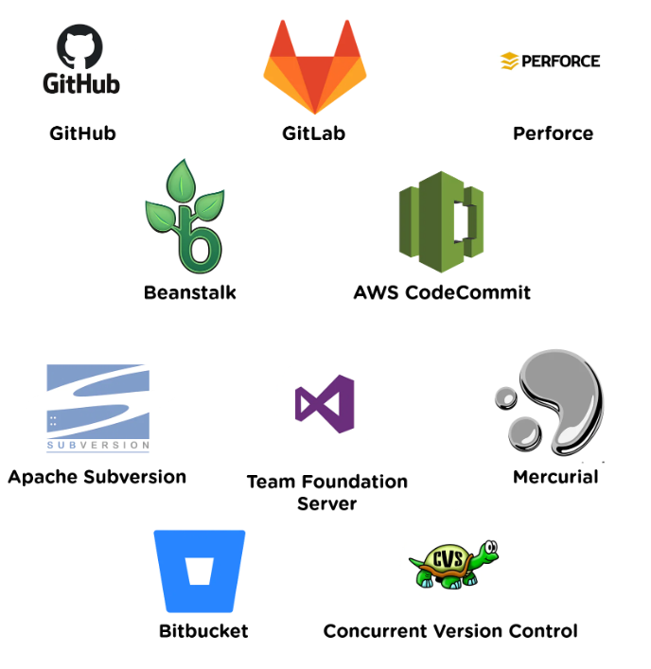
What is Version Control System?
Version control enables multiple team members to work on a single project at the same time.
Each member edits his or her own copy of the files and chooses when to share those changes with the rest of the team.
The best Version Control Systems tools in the market.

Slide 4
What Are Its Benefits?
Enhances the project development speed by providing efficient collaboration
Version control gives access to historical versions of your project and Keeping Track of All the Modifications Made to the Code.
Version control gives access to revert changes.
Managing and Protecting the Source Code (You can Organize features)

Slide 5
What are Git and GitHub?
Git
Git is a Version Control System (VCS) designed to make it easier to have multiple versions of a code base, sometimes across multiple developers or teams
It allows you to see changes you make to your code and easily revert them.

Slide 6
What are Git and GitHub?
GitHub
GitHub is a code hosting platform for version control and facilitates the sharing of codebases among teams by providing a GUI to easily fork or clone repos to a local machine
GitHub.com is a website that hosts git repositories on a remote server.

Slide 7
What are common words that used in version control system (VCS)?
A repository (repo): It can be thought of as a database of changes. It contains all the edits and historical versions (snapshots) of the project.
Branch : A branch is a parallel version of a repository. It is contained within the repository but does not affect main branch.
Clone : A clone is a copy of a repository that lives on your computer.
Pull :Pull refers to when you are fetching in changes and merging them.
Push :send your committed changes to a remote repository on GitHub.com
Fetch: When you use git fetch, you're adding changes from the remote repository to your local working branch without committing them. Unlike git pull, fetching allows you to review changes before committing them to your local branch.

Slide 8
Words you will hear when use version control system
Merge: Merging takes the changes from one branch (in the same repository) and applies them into another. This often happens as a "pull request" (which can be thought of as a request to merge), or via the command line.
Merge conflict : A difference that occurs between merged branches. Merge conflicts happen when people make different changes to the same line of the same file, or when one person edits a file, and another person deletes the same file. The merge conflict must be resolved before you can merge the branches.
Pull request: Tell Other about your changes to pull I from remote repo, repository’s admins can reject or accept your code changes

Slide 9
Version control best practices
1
Create Repo for every project.
2
Create a new branch for every feature or enhancement.
3
Use a descriptive commit message.
4
Make each commit a logical unit : Each commit should have a single purpose and should completely implement that purpose.
5
Share your changes frequently
6
Don't commit generated files (For example, do not commit binary files that result from compilation, such as .o files or .class files)

Slide 10


Slide 11
List of useful Git & GitHub Commands
git status : To see what's changed since last commit. It shows all the files that have been added and modified and ready to be committed and files which are untracked. 2.git config
git Config : To set the basic configurations on GitHub like your name and email.
git init: To create a local git repository for us in our store folder. This will help to manage the git commands for that particular repository.
git add Readme.txt : To add a file Readme.txt to the staging area to track its changes.
git commit -m “Created a Readme.txt” : To commit our changes(taking a snapshot) and providing a message to remember for future reference.
git log :To check the history of commits for our reference.
git add : To add a specific list of files to staging area.
git add –all :To add all files of current directory to staging area. git diff: To figure out what changes you made since last commit.
git reset head license: To undo staging of the file that was added in the staging area.
git checkout –license: To Blow away all changes since the last commit of the file.
git branch : To see all branches on your repo.
git remote -v : To see remote repo (global server).
git branch <new branch>: To create a new branch named as Testing.

Slide 12


THANK YOU

